Slide 1

MSB4182
SOCIAL ENTREPRENEURSHIP
Lesson 3
CUSTOMER AND SOLUTION

Slide 2
OBJECTIVES
In this lesson, you will discover your customer in terms of
Understanding Market Types,
Identifying your Customer Segments,
Niche,
Early Adopters,
Listing down customers' Jobs, Pains & Gains,
Creating customer Personas, and thereby
proposing value added solutions to solve customer problems worth solving.

Slide 3
OUTCOMES
At the end of this lesson, you will be able to:
Differentiate between a customer and a consumer.
Learn about the different market types and their specific requirements.
Identify your customer segments and niche, and understand their jobs, pains, and gains.
Identify the early adopters and understand the importance of this customer segment.
Bring your customer to life by creating customer personas.
Craft your solutions using the left section of the Value Proposition Canvas by defining the gain creators and pain relievers.
Apply Outcome Driven Innovation to identify what else your product can do to get a “wow” from the customer.

Slide 4
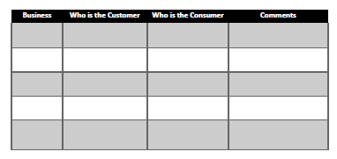
CUSTOMER VS. CONSUMER
Differentiate between a customer and a consumer.

Slide 5
TYPES OF STARTUPS
4 types
Existing
New Market
Re-segmented
Clone

Slide 6
TYPES OF STARTUPS
EXISTING
When investors and entrepreneurs go after an existing market – the advantage is that there’s little or no market risk.
In this market type:
• Competitors exist
• Customers want and need better performance
• Technology is usually the driving factor
• The positioning is driven by the product and how much value customers place on its features
• The risk is to think that competitors are dumb or too slow
• There is no "chasm" that you need to fill. The chasm is the gap between early adopters and the mainstream customers in a market.

Slide 7
TYPES OF STARTUPS
NEW MARKET
Customers do not exist in the present, so revenue generation takes years
• Market size is zero
• Customers need to be made aware of their needs
• You must consider what factors can you create that has never been offered
• The chasm is biggest here because you will only be selling to the very early adopters
For a new market to take off, there are many things that you need to consider. For example, who is the customer? and what customer pain/problem are you trying to solve?

Slide 8
TYPES OF STARTUPS
RE-SEMENTED MARKET
The Re-segmented market is a hybrid between a New market and an Existing market in the sense that it is a New Market created from a small segment from an existing market.
The features of this market type are:
• Low cost
• New Niche

Slide 9
TYPES OF STARTUPS
RE-SEMENTED MARKET
In this market type:
• Evaluate factors that your industry has long competed on and eliminate those
• Evaluate what factors can be reduced well below the industry standards
• Evaluate what factors can be increased above the industry standards
• Evaluate what factors can be created that have never been offered
• There is a bit of a chasm in this type of market

Slide 10
TYPES OF STARTUPS
CLONE MARKET
In a Clone market, customers are known because you copied an existing market.
It is called a Clone because, in this market type, you are going to localize all those specific issues for your country or region.
That said, it takes a foreign business model and adapts it to local conditions.
There are no competitors if you are the first one and the risk may be in misjudging the local needs.
This market type:
• Adapts a foreign business model to a local condition (language, culture, import restrictions, and local regulations)
• Needs a large number of customers, typically >100 million

Slide 11
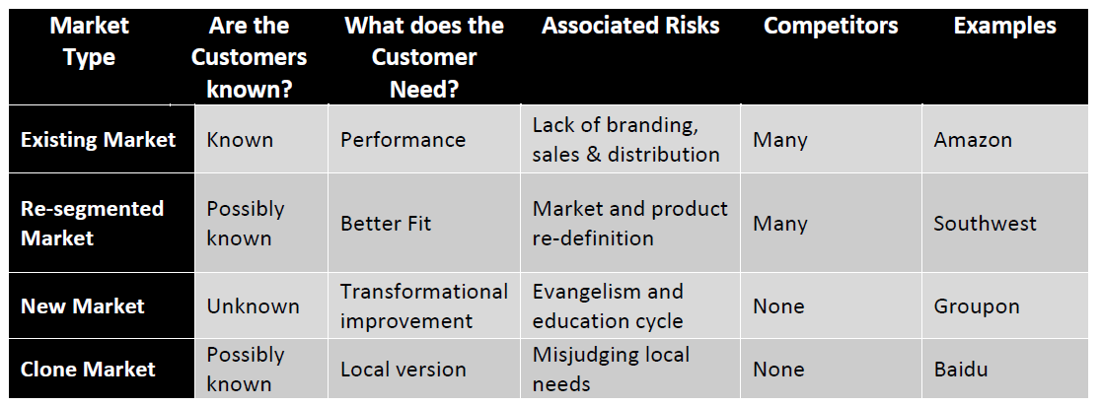
TYPES OF STARTUPS

